Slide 1
Mangesh Chavan App Issues 15-11-2023

Slide 2
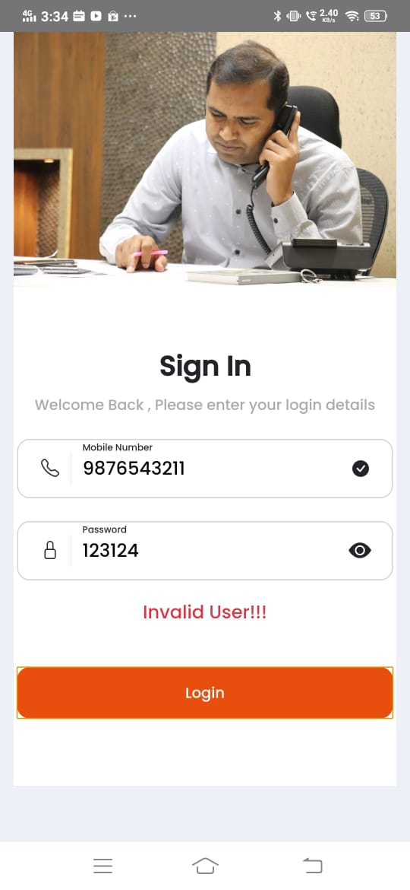
Instead of Invalid User message >>Wrong Password/Wrong username message should be displayed

Slide 3
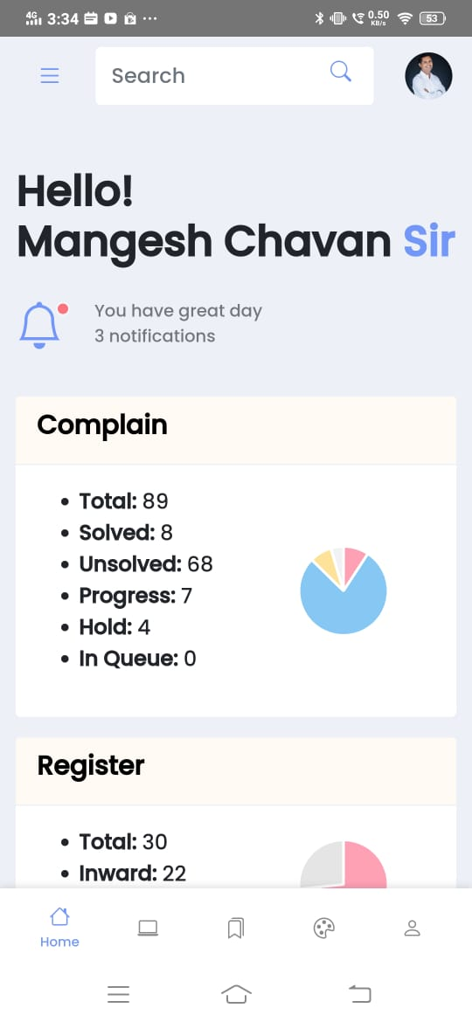
There is no need of this section(profile) here
The Notification bell icon should be small. it should replace the image of mangesh chavan

Slide 4
We should redesign these two CARD’s

Slide 5
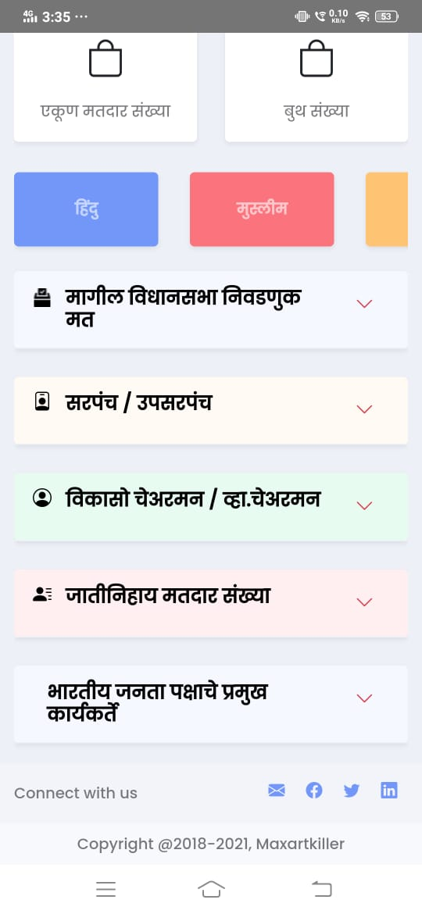
Change the icon with election finger icon
Change the icon with Hut icon
In all app these acrodian should show a message of data not found if a field does not have a data
Put the icon of lotus here

Slide 6
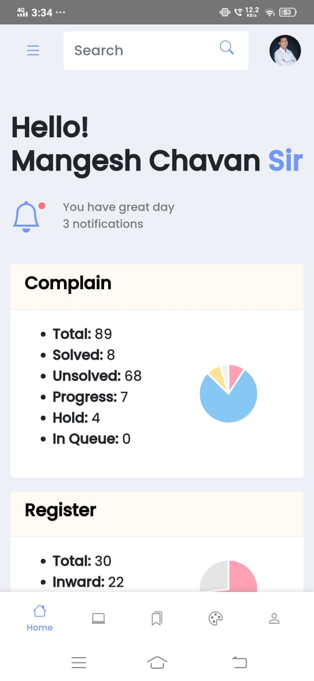
Search box is not working

Slide 7
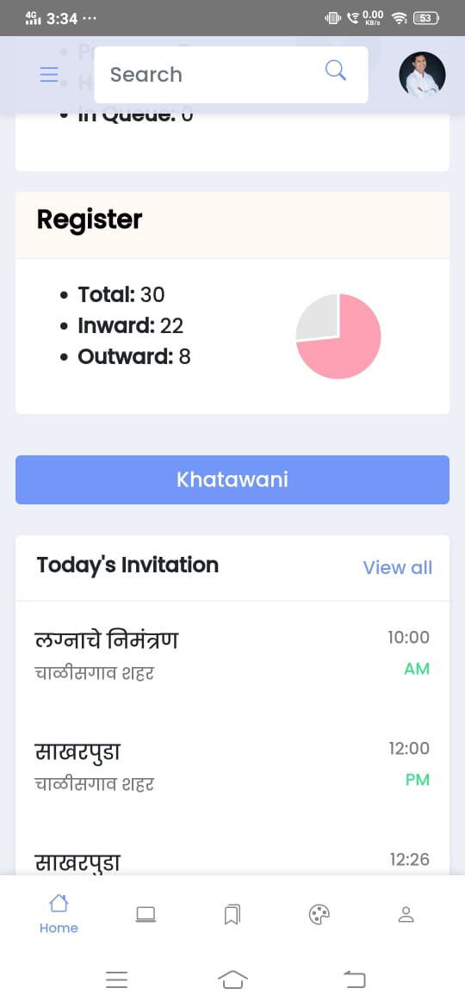
Khatawani button should be bigger. There should also be a icon in the button

Slide 8
When we click on this back button. The application is getting log out

Slide 9
Khatawani page is not displaying “select city/village screen” as compare to 3 dot/menu screen

Slide 10
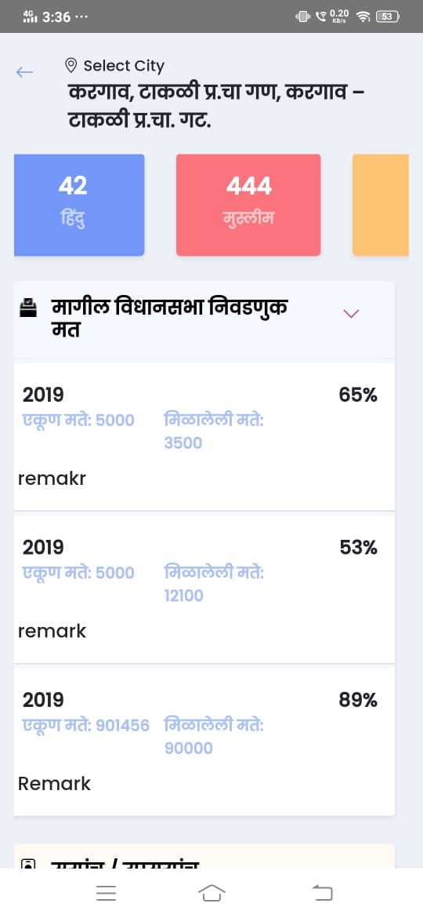
Label text color and value text color should be different

Slide 11
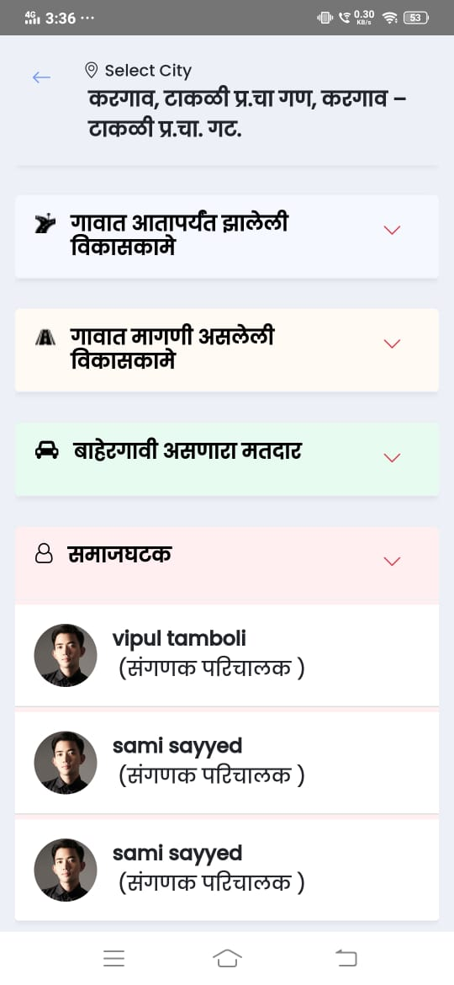
Acrodian should be upward if a screen is open

Slide 12
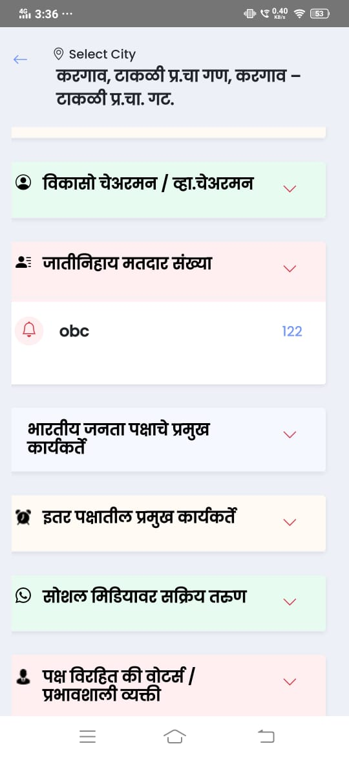
Replace the bell icon with “men/human”icon

Slide 13
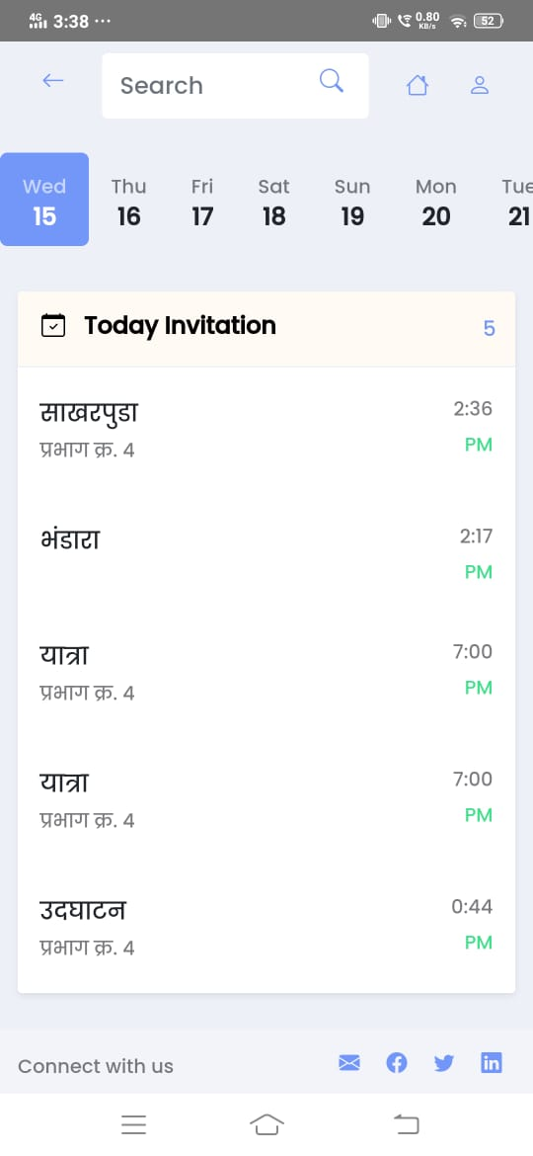
When we select a later date it should highlight that date .currently only today’s date is highlighted

Slide 14
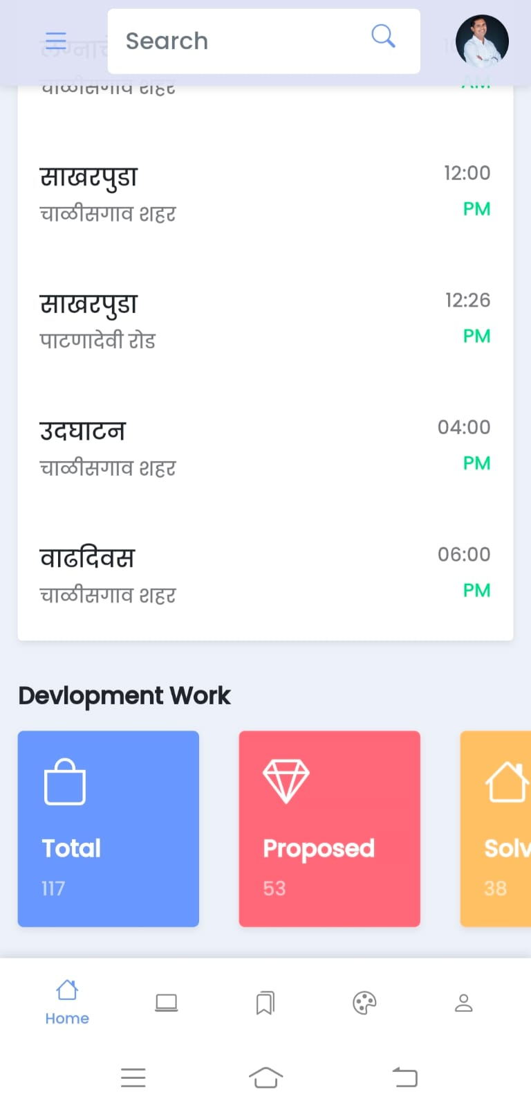
We need to change all the icon’s in this section

Slide 15
We have to redesign this page.
We need to add mobile no. of samaj ghatak

